Slide 1
Spring 2024 Physics SABI Case
Joseph Wishart, MS
Kalpana Kanal, PhD, DABR
University of Washington, Seattle, WA

Slide 2
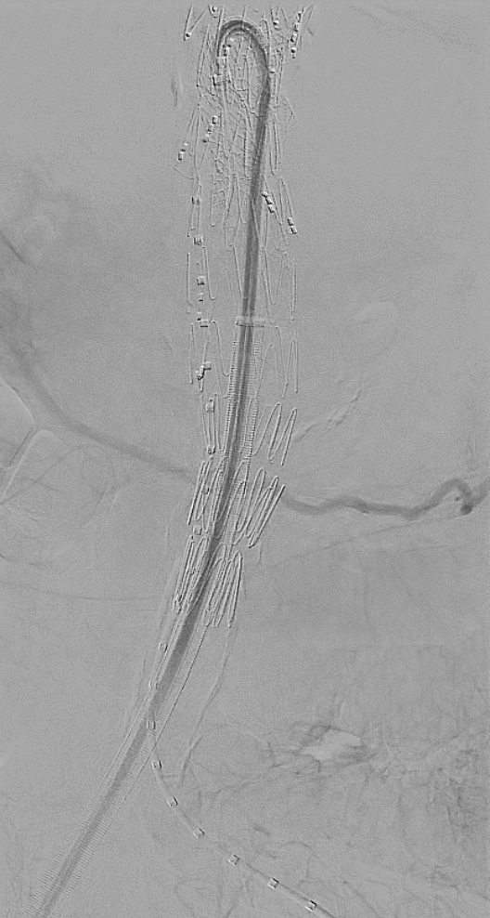
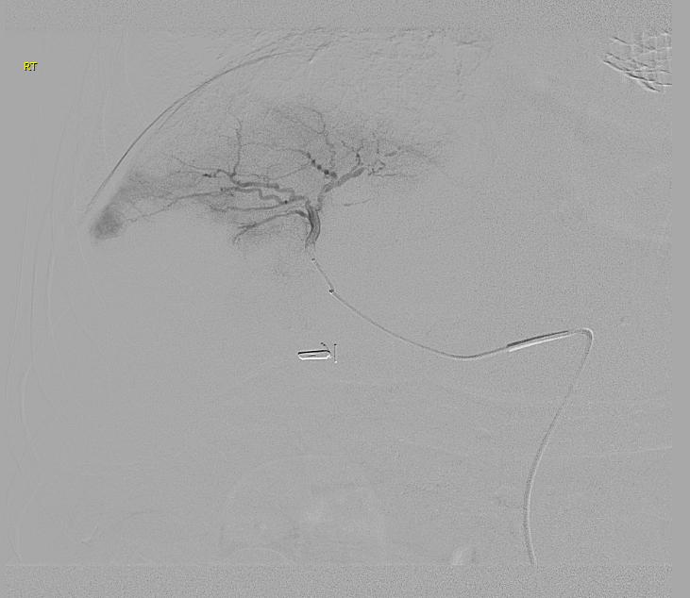
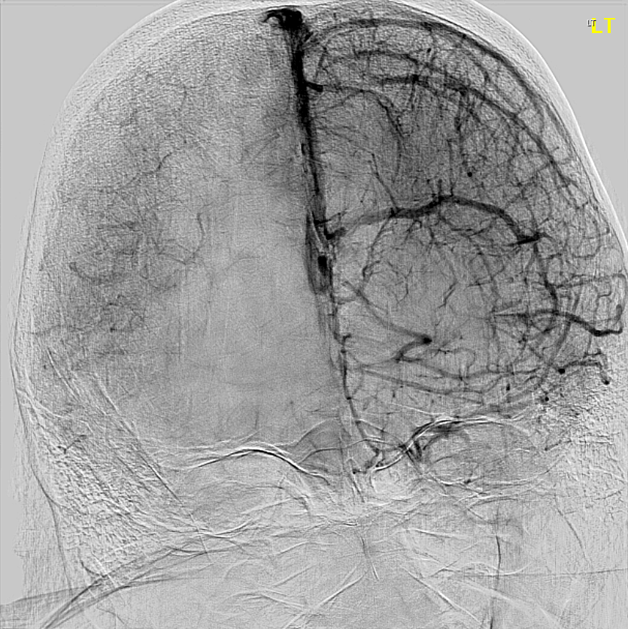
Question 1
What is the cause of the artifacts indicated in the following digital-subtraction angiography (DSA) frames?
Beam Hardening
Motion
Contrast Leakage
Detector Interference

Slide 3
Teaching points
No Motion
Digital subtraction angiography is a fluoroscopic acquisition technique used to highlight vessels
A mask image is first acquired
Contrast is injected as proceeding images are taken
The mask image is logarithmically subtracted from each new frame
Subtraction removes any common anatomical element present between mask and following images
Any motion results in a difference in physical position of anatomy relative to the mask
This induces a subtraction artifact
Modern systems employ processing techniques to mitigate motion
Mask Image
Contrast Image
DSA
Motion
Mask Image
Contrast Image
DSA

Slide 4
Question 2
During DSA, the dose rate to the patient is generally _________ the rate used in standard fluoroscopy.
2x
1/2
5x
>10x

Slide 5
Example from Physics Testing
As part of annual physics testing, radiation output is measured for common exams under standard fluoroscopy and Cine/DSA mode – see example below
*Cine/DSA rates are clearly much higher than standard fluoroscopy
**Note the higher doses for higher magnification as well
Mode | FOV (Magnification Mode) | Dose Rate (R/min)
Fluoroscopy | 19” (Full field) | 0.04
Cine/DSA | 19” (Full field) | 6.52
Fluoroscopy | 6” (Max magnification) | 0.43
Cine/DSA | 6” (Max magnification) | 29.83

Slide 6
Cine, Fluorography, DSA
Meant to be recorded and saved
Higher image quality required for diagnosis
Higher doses to achieve sufficient image quality
Fluoroscopy
Noisy, grainy – for structure and placement
Cine/Fluorography/DSA
Higher dose, less noise – use for interpretation
https://radiopaedia.org/articles/fluoroscopy-vs-fluorography?lang=us

Slide 7
Question 3
When doing a contrasted-enhanced DSA run, it is often desirable to have the later images be acquired at a
Higher in radiation output
Lower in radiation output
Higher frame rate
Lower frame rate

Slide 8
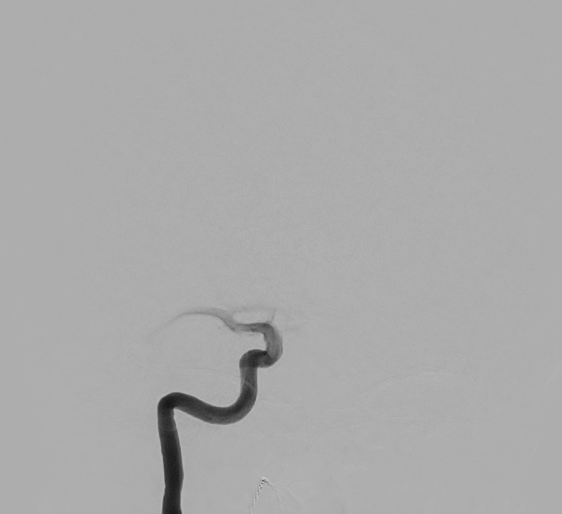
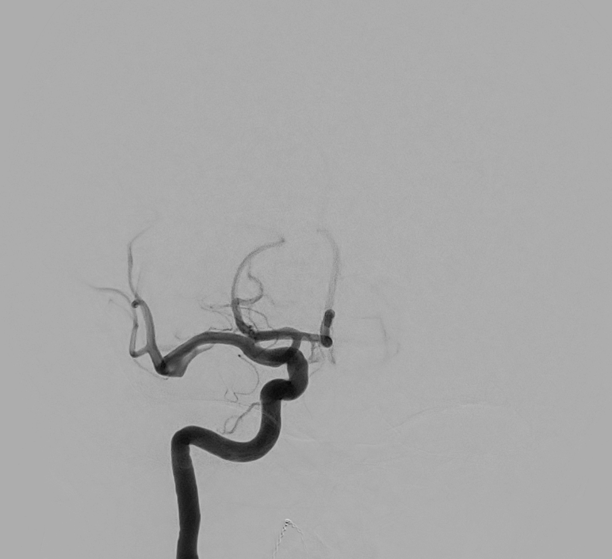
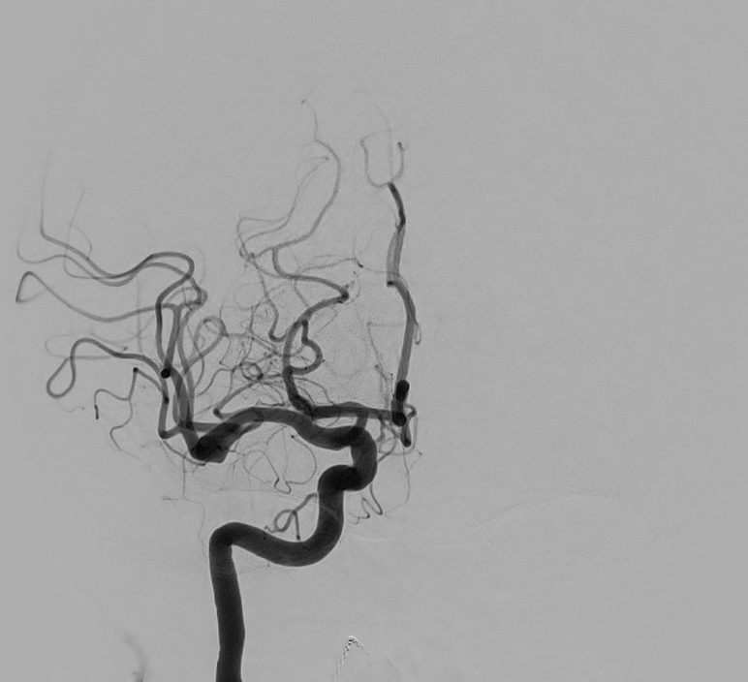
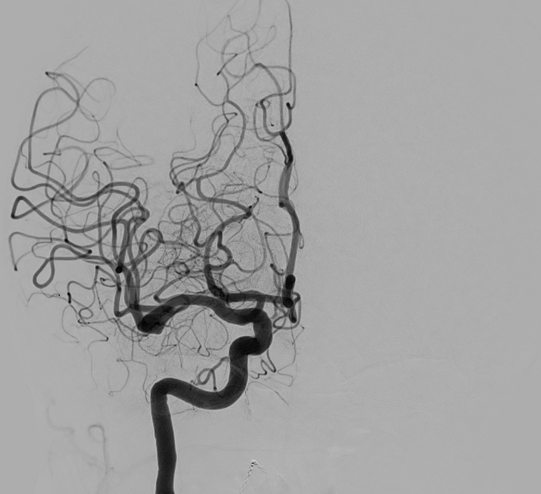
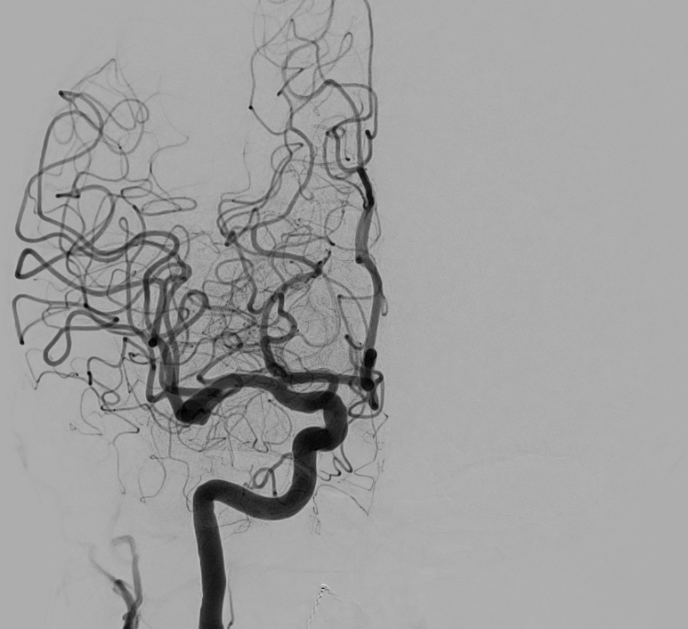
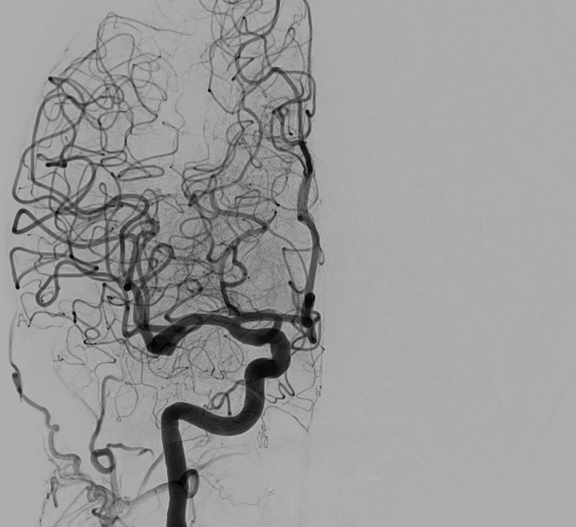
Initial perfusion = Fast (high frame rate) Later Perfusion = Slow (low frame rate)
$$Frame Rate=3 fps$$
$$(∆t=333 ms)$$
$$Frame Rate=1 fps$$
$$(∆t=1000 ms)$$

Slide 9
Primary Goal: Make a successful image(s) for diagnosis or guidance
Requirements
Image quality
Anatomical coverage
Functionality assessment
Optimize contrast timing/rate
Modify frame rate for contrast phase
Collimate to the area of interest
Magnify when necessary
Optimize kVp, filtration, frame rate
By…

Slide 10
References
Meijering, E. H. W., Niessen, W. J. and Viegever, M. A. Retrospective motion correction in digital subtraction angiography: a review.IEEE Transactions on Medical Imaging, vol. 18, no. 1, pp. 2-21, Jan. 1999, doi: 10.1109/42.750248.
Yi HJ, Sung JH, Lee DH, Kim SW, Lee SW. Analysis of Radiation Doses and Dose Reduction Strategies During Cerebral Digital Subtraction Angiography. World Neurosurg. 2017 Apr;100:216-223. doi: 10.1016/j.wneu.2017.01.004. Epub 2017 Jan 12. PMID: 28089806.
Nickoloff, E. L. AAPM/RSNA Physics Tutorial for Residents: Physics of Flat-Panel Fluoroscopy Systems. RadioGraphics. 2011 Mar;31(2): doi: 10.1148/rg.312105185.
Soderman, Michael. Image Noise Reduction Algorithm for Digital Subtraction Angiography: Clinical Results. Radiology. 2013 Nov; 269(2): doi: 10.1148/radiol.13121262.

