Slide 1
MRI Artifacts
Angela Tong, MD
Clinical Assistant Professor
NYU Langone Health

Slide 2
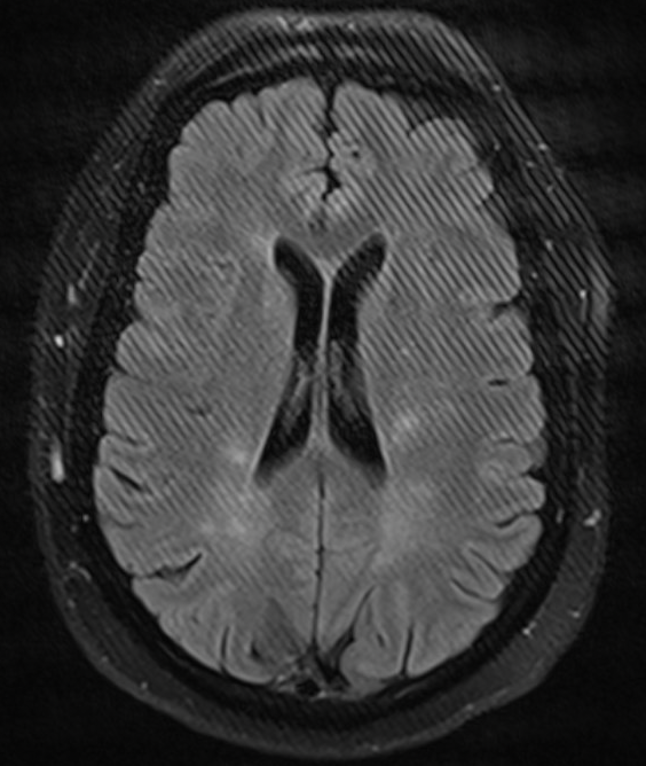
This artifact is caused by:
Open door to the scanner
Cochlear implant
Aberrant data point in k-space
Under-sampled data

Slide 3
This artifact is caused by:
c. Aberrant data point in k-space
Also known as spike artifact, this artifact is caused by an aberrant data point in the raw k-space data. K-space data undergoes Fourier Transform to produce an image. An aberrant data point results in parallel lines at a single frequency.
An open door would cause a single line through the image, called a zipper artifact. A cochlear implant would cause susceptibility artifact. Under-sampled data would cause increased noise.

Slide 4
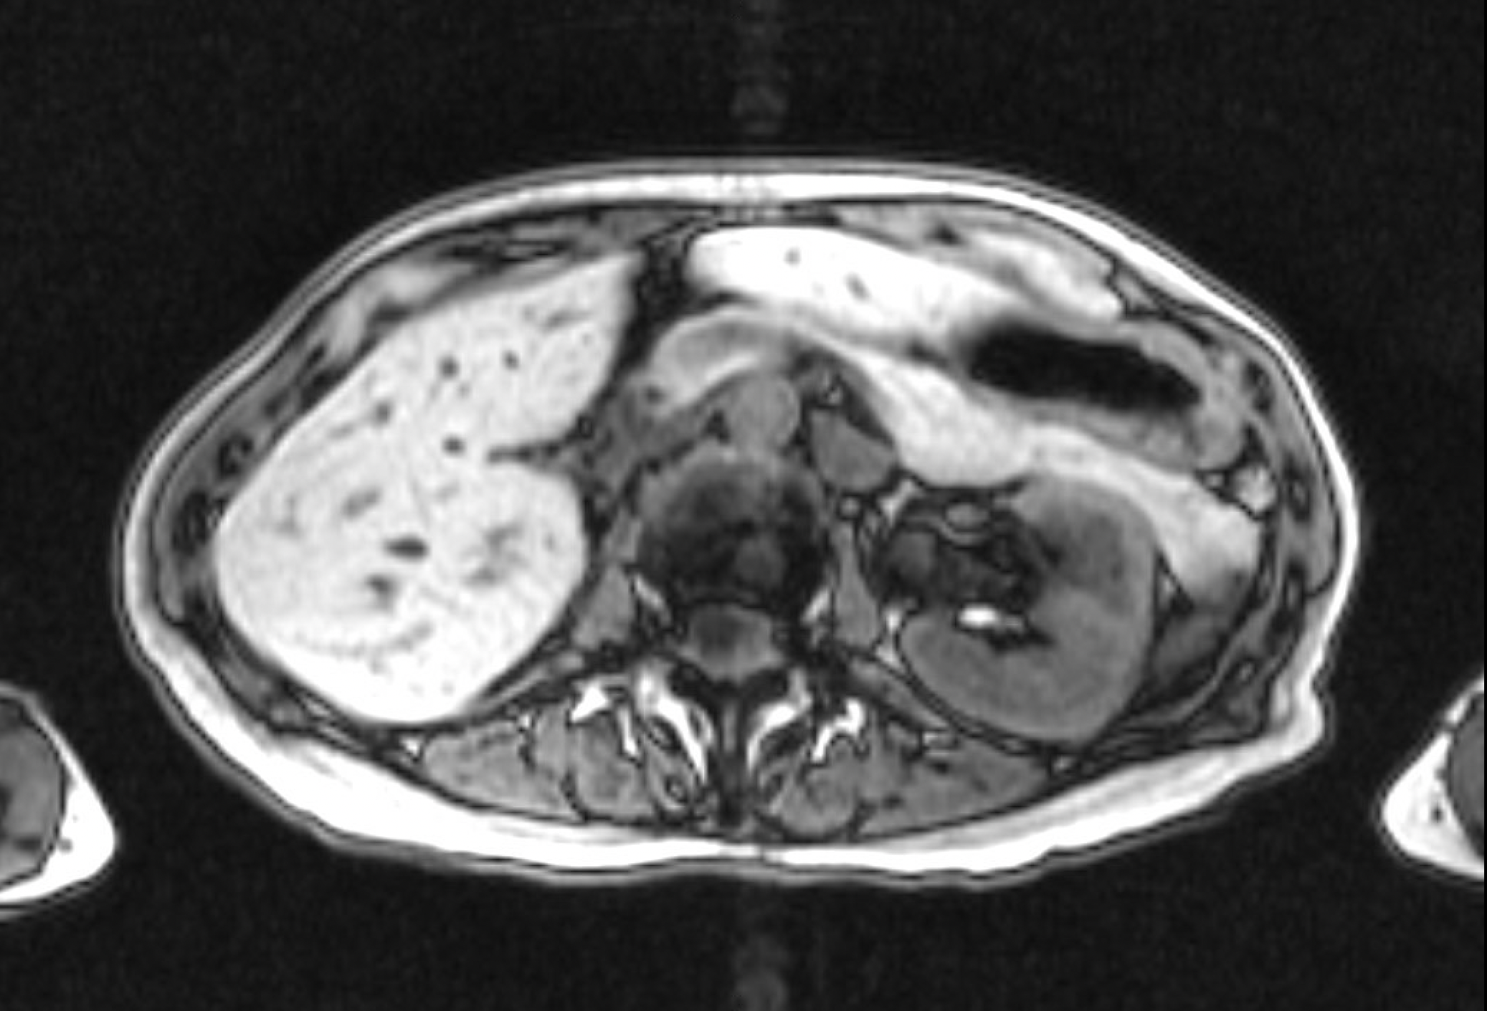
67 year old patient with renal cell carcinoma
True or False:
Patient has a bony metastasis in the left posterior vertebrae.

Slide 5
67 year old patient with renal cell carcinoma has a vertebral metastasis.
FALSE
The artifact Pulsation artifact from the motion of the aorta causes ghosting artifact in the phase-encoding direction on the vertebrae (arrow). The artifact matches the shape of the original pulsating object, the aorta (arrow head). This is a pitfall and can mimic pathology, such as a bony lesion in this case.

Slide 6
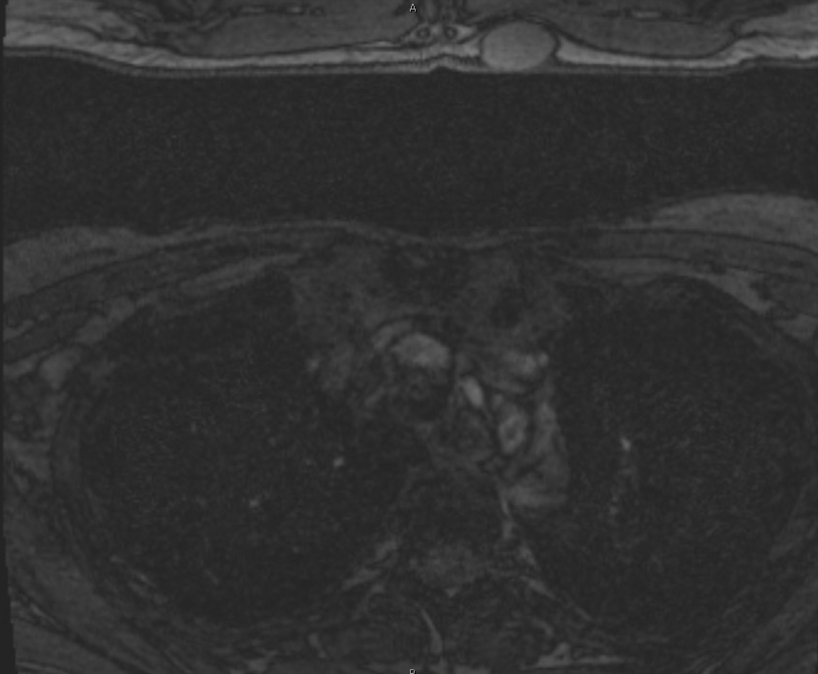
What should one do to remove the artifact from this image?
Increase the field of view
Check for metallic implants in the patient
Repeat scan with improved patient instructions
Change phase-encoding direction

Slide 7
What should one do to remove the artifact from this image?
a. Increase the field of view
“Aliasing” or “wrap-around” artifact is caused by imaging a body part whose dimensions exceed the field-of-view. The imaged body part outside the field-of-view is projected on the opposite side of the image.

